Slide 1



Slide 2

POWER BI
Exploring & Enriching Data

Slide 3

Objectives
What We’ve Covered So Far
Competitive Landscape​
Terminology & Navigation​
Loading Txt Data​
Visualizations

Slide 4
Objectives
Today’s Objectives EDA
Gartner’s Value Escalator for Analytics Statistics
Review the Value of Descriptive Statistics
Create and manage relationships between tables
Building Additional Visualization Types
App Source Specialty Chart Options

Slide 5
Objectives
Today’s Objectives Walkthrough
Terms, Navigation & Competition
Loaded Data from CSV
Navigated Power Query Editor
Cleaned and reshaped data
Created Charts with Filters & Formatting
Recreated and extended the Citibike dashboard with a navigation button!

Slide 6
Exploring & Enriching Data
Analysis with Statistics

Slide 7
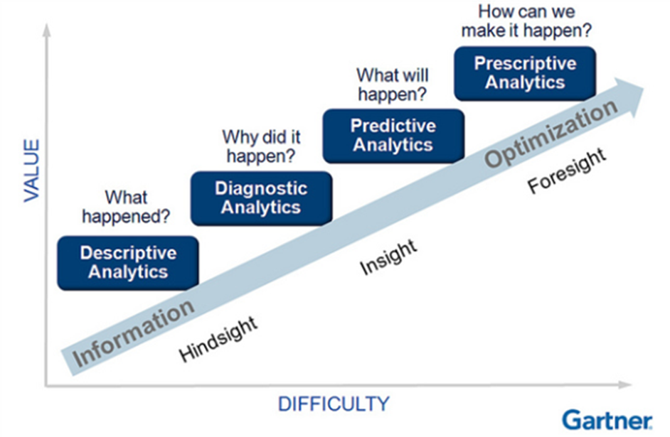
Gartner’s Data Analytics Maturity Model
“New best practices and frameworks are needed for defining and architecting the integration of analytical capabilities with new combinations of information sources and business processes.”
Notes:
This has been referred to as the "data analytics maturity model" and the "analytic value escalator".
Source: https://www.gartner.com/en/documents/1964015/best-practices-in-analytics-integrating-analytical-capab

Slide 8
Analysis with Statistics
Summary Statistics
Descriptive: What happened? Establishes trajectory.
Diagnostic: Why did it happen? Looks for root causes.
Predictive: What will happen? Learns correlated factors.
Prescriptive: How can we make it happen? Facilitates action.
https://www.wallstreetmojo.com/features-of-power-bi/

Slide 9

Quiz!
What can descriptive statistics do?
A. Describe data and tell us about the past.
B. Describe data and tell us about where we need to be.
C. Describe the past and tell us about the future of our data.
Respond in Thread
Notes:
ANSWER: A

Slide 10
Quiz!
Fill in the blanks:
Measures of Central Tendency tell us about the ________ of the data. At a basic level, what one might expect to happen again.
Measures of __________ tell us how “spread out” the data is, or how far individual values stray from the center. These measures include __________ and ___________ .
Respond in Thread
Notes:
ANSWER:
CENTER
Dispersion; Variance; Standard Deviation

Slide 11
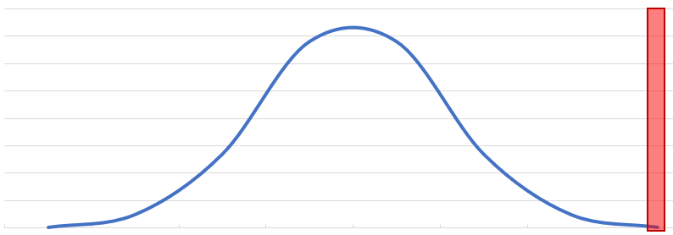
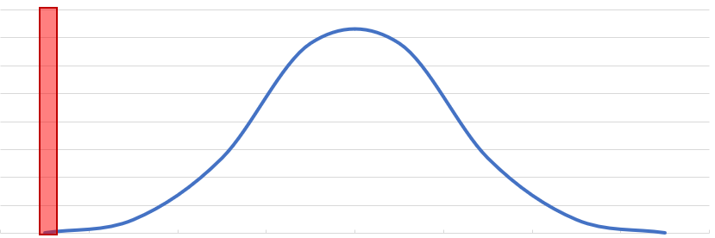
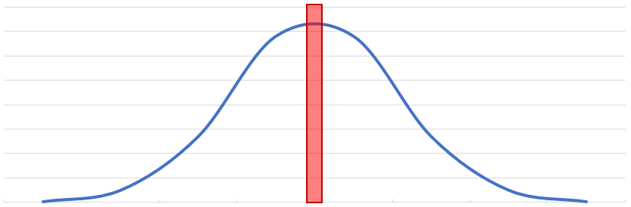
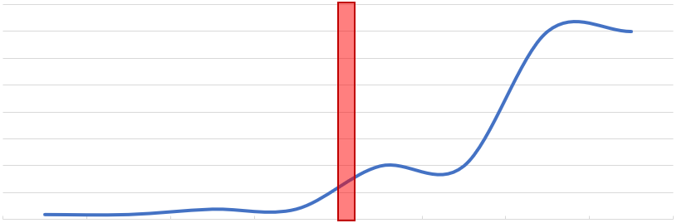
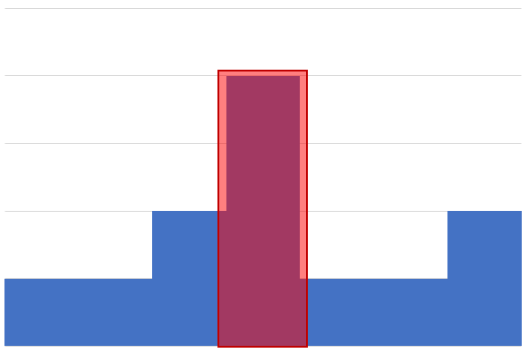
Value of Descriptive Statistics
Statistic | How to Calculate | Plot
Max | Maximum (largest) value in the range; identify by ordering the data set.
Min | Minimum (smallest) value in the range; identify by ordering the data set.
Mean | Mathematical midpoint in the range. Sum the range, divide by the number of values in the range.
Median | Presented midpoint in the range. Order the data set, then look for the middle value.
Mode | Value most commonly found in the data set. Order the data set and count frequency of each value.
Notes:
These indicate the BOUNDARIES of the data without describing the DISTRIBUTION of the values (how closely they cluster around the mean value).

Slide 12
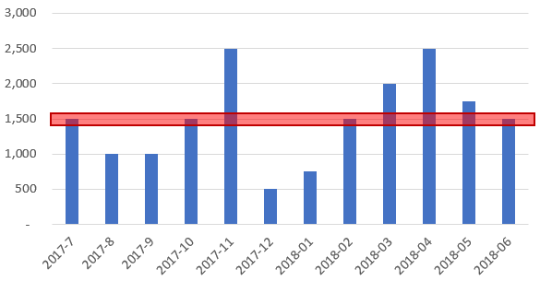
Descriptive Statistics Misapplied
Summary statistics establish trajectory – giving a general "sense" of the values.
What If? Inventory is allocated based on the single data point of a mean of 1,500 units per month.
Based on the reality of this chart --- what would be the impact of that decision?
Not a precision decision making tool!

Slide 13
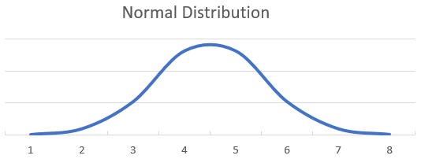
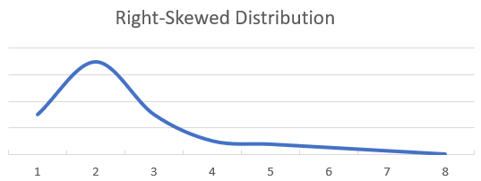
Data Distributions or Dispersion
A normal distribution (a.k.a., bell curve) is dense in the center of the distribution (the mean) and has equal tails. The observed mean and median will have roughly the same value.
A right-skewed distribution is asymmetric, with a longer tail to the right. Observed median will be less than the mean.
Left-skewed has a longer tail to the left, with a mean less than the median.
Notes:
These indicate the BOUNDARIES of the data without describing the DISTRIBUTION of the values (how closely they cluster around the mean value).

Slide 14
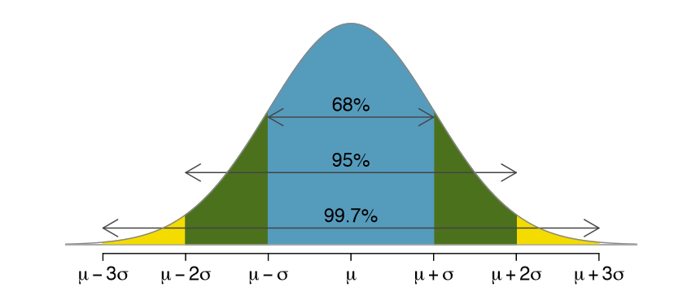
Normal Data Distributions
A normal distribution of data from the mean value says,
68% within one standard deviation;
95% two standard deviations of the mean; and,
99.7% within three standard deviations of the mean.
Notes:
These indicate the BOUNDARIES of the data without describing the DISTRIBUTION of the values (how closely they cluster around the mean value).

Slide 15
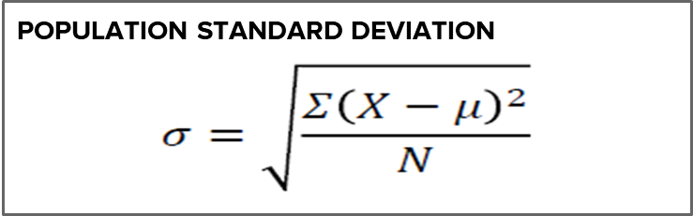
Measures of Dispersion
Variance
- measure of distance from the mean.
- a squared value, making it difficult to directly compare against values in the data set.
Standard deviation - square root of variance. - a measure of data dispersion from the mean. - closer to zero indicates a tightly clustered sample. - large standard deviation indicates more variability in the data.
Notes:
These indicate the BOUNDARIES of the data without describing the DISTRIBUTION of the values (how closely they cluster around the mean value).

Slide 16
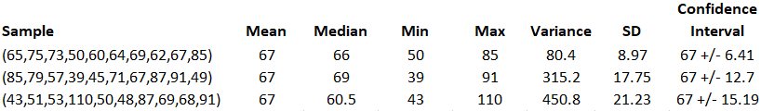
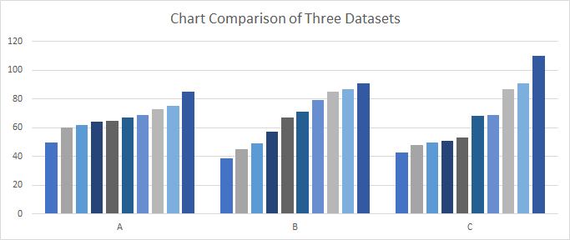
Measures of Dispersion
Each sample has a mean value = 67; but they have different dispersion values.
A B C
Notes:
These indicate the BOUNDARIES of the data without describing the DISTRIBUTION of the values (how closely they cluster around the mean value).

Slide 17
Descriptive Statistics Value
Descriptive statistics describe data and tell us about the past.
These statistics may be based on evaluating the range, central tendency, or dispersion of the data set:
Range: Min and max.
Central Tendency: Mean, median, and mode.
Dispersion: Variance, standard deviation.
Data sets can present in many different distributions:.
Normal distribution is centered around the mean.
Skewed distributions rise sharply and then trail off.
Notes:
These indicate the BOUNDARIES of the data without describing the DISTRIBUTION of the values (how closely they cluster around the mean value).

Slide 18
Exploring & Enriching Data
Adding Tables, Enriching Data & Visualization Charts

Slide 19
Exploring & Enriching Data
Next, we will interactively:
Add data to an existing model.
Enrich the data that is present.
Build additional visualizations, like:
Multiple Bar and Column Charts
Pie, Donut and Treemaps (Parts of Whole)
Conditional Formatting (Symbols & Color)
App Source Additional Visualization Types.

Slide 20
Citibike Walkthrough (video 1: PowerBI day 2 Citibike Walkthrough Part One.mp4) (video 2: PowerBI Day 2 Citibike Walkthorugh Part Two.mp4)

Slide 21
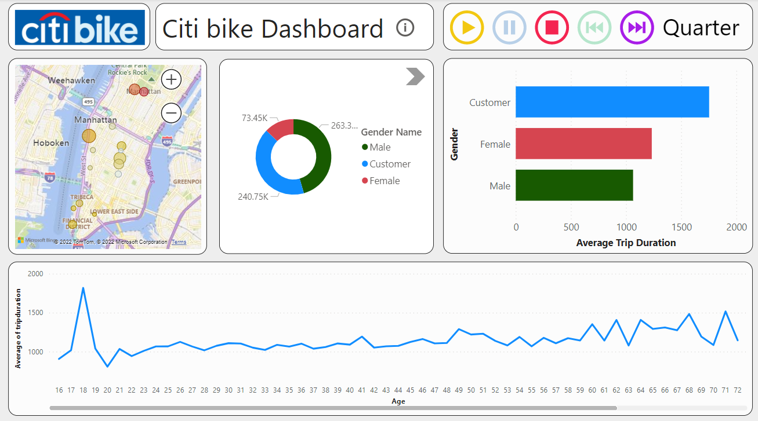
Citibike Goal Dashboard

Slide 22
Great Work Today!
Questions?

Slide 23


